Slide 1
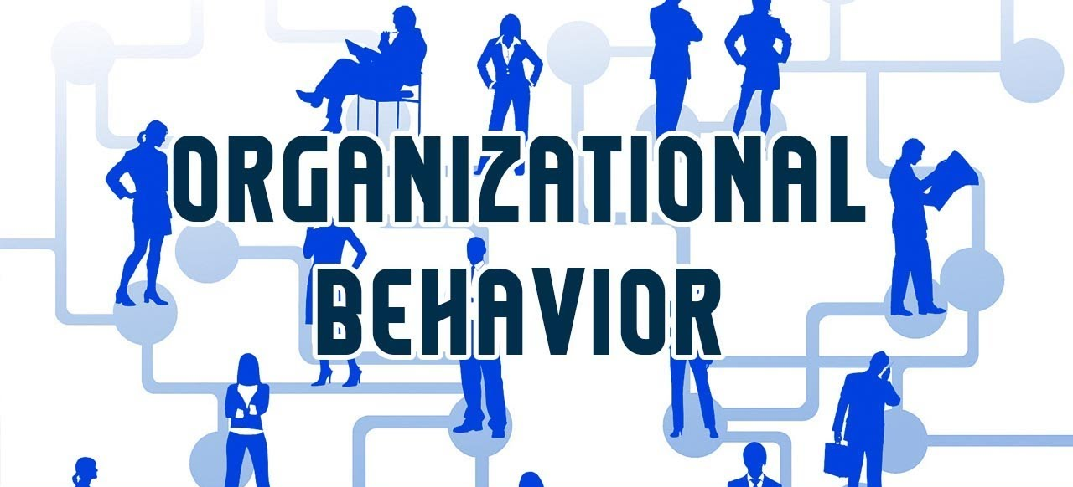


Personality & Values
Instructor: Dr. Muhammad Rafiq
Chapter 5: Organizational Behavior – 15th Edition

Slide 2
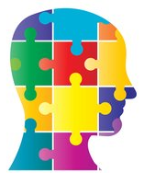
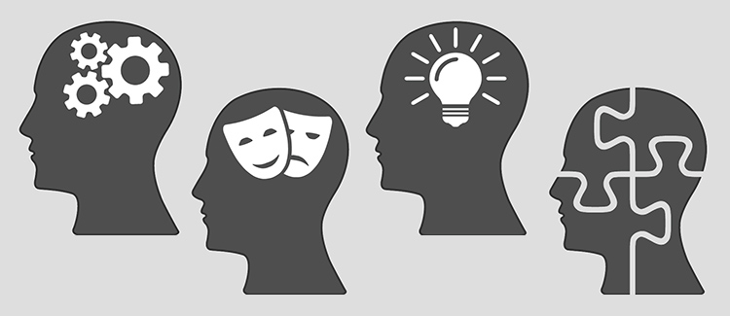
Personality
Personality
The sum total of ways in which an individual reacts and interacts with others; measurable traits a person exhibits.
Personality may be understood as characteristic pattern of behavior and modes of thinking that determine a person’s adjustment to the environment.
Personality Traits
Enduring characteristics that describe an individual’s behavior.
Personality Determinants
Heredity
Environment
Situation

Slide 3
Personality?
Why are some people quite and passive and others are loud and aggressive?
Are certain types better adjusted to certain types?
Can personality change over time?
Do we require all kinds of personalities in a team?
How is training and development helpful in Personality grooming?
Can we assess/measure personality?
What are different kinds of personality traits?

Slide 4
The Myers-Briggs Type Indicator
Myers-Briggs Type Indicator (MBTI)
A personality test that taps four characteristics and classifies people into 1 of 16 personality types.
Personality Types
Extroverted vs. Introverted (E or I)
Sensing vs. Intuitive (S or N)
Thinking vs. Feeling (T or F)
Judging vs. Perceiving (P or J)
Score is a combination of all four (e.g., ENTJ)
Notes:
The original ideas of the Myers-Briggs Type Indicator (MBTI) were created by Carl Gustav Jung in 1921. • The actual test was officially published in 1962. The test was created to help determine which careers would be best for women as they entered the workforce for the first time during WWII. • It is a psychological analysis examination that determines a person’s psychological makeup and how they perceive and make decisions. The test is made of four different dichotomies or personality descriptions. One can either be: 1. Introverted or Extroverted 2. Sensing or Intuitive 3. Thinking or Feeling 4. Judging or Perceptive

Slide 5
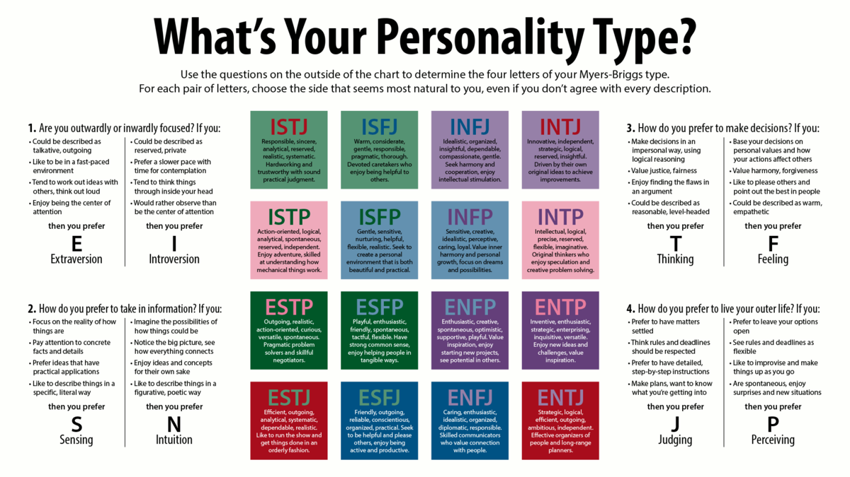
Personality Theories / Model
Myers-Briggs Type Indicator

Slide 6
Extraversion/Introversion
Extraversion:
A preference indicating that an individual is energized with other people.
Introversion:
A preference indicating that an individual is energized by time alone.
EXTRAVERSION-(E)
Outgoing
Publicly Expressive
Interacting
Speaks, then thinks
Gregarious
INTROVERSION- (I)
Quiet
Reserved
Concentrating
Thinks, then speaks
Reflective
Notes:
These are two different attitudes to the world around us.
When you are in the extraverted attitude, you relate more easily to the world of people and things outside of you.
When you are in the introverted attitude, you relate more easily to the ideas and concepts in your mind
Likes variety and action
Enjoys talking out loud about ideas
Demonstrates energy and enthusiasm
Is stimulated by, and responsive to, people and actions in the environment
May be easily distracted
Expresses thoughts and feelings openly
Is energized by being with others
Acts before thinking
Is friendly and talkative
May be Impatient with long, slow projects
Values friends and relationships

Slide 7
2-Sensing/Intuiting
Sensing:
Gathering information through the five senses.
Intuiting:
Gathering information through “sixth sense” and focusing on what could be rather than what actually exists.
SENSING - S
Practical
Specific
Feet on the ground
Details
Concrete
INTUITING - N
General
Abstract
Head in the clouds
Possibilities
Theoretical
Notes:
These are 2 different ways of gathering information.
When you are perceiving with your sensing process, you are interested in your 5 senses show you (what exists in the present)
When you are perceiving with your intuition, you are using your imagination to see new possibilities and insights hidden from the eye.

Slide 8
3-Thinking / Feeling
Thinking
Making decisions in a logical, objective fashion.
Feeling
Making decisions in a personal, value oriented way.
THINKING - T
Analytical
Clarity
Head
Justice
Rules
FEELING - F
Subjective
Harmony
Heart
Mercy
Circumstances
Notes:
These reflect 2 kinds of decision making.
When you make judgments with your thinking, you base your decisions on impersonal analysis and logic.
When you make judgments with your feeling, you base your decisions on your values.

Slide 9
4-Judging / Perceiving
Judging
Preferring closure and completion in making decisions.
Perceiving
Preferring to explore many alternatives and flexibility.
JUDGING - J
Structured
Time Oriented
Decisive
Makes lists/
uses them
Organized
PERCEIVING - P
Flexible
Open ended
Exploring
Makes lists/
loses them
Spontaneous
Notes:
These are 2 ways of living in the world around us.
When you are living by your judgment, you like to have things decided; your life is likely to be planned and orderly.
When you are living by your perception, you don’t want to miss anything; your way of life is likely to be spontaneous and flexible.

Slide 11
Meyers-Briggs, Continued
A Meyers-Briggs score
Can be a valuable too for self-awareness and career guidance.
BUT
Should not be used as a selection tool because it has not been related to job performance!!!

Slide 12
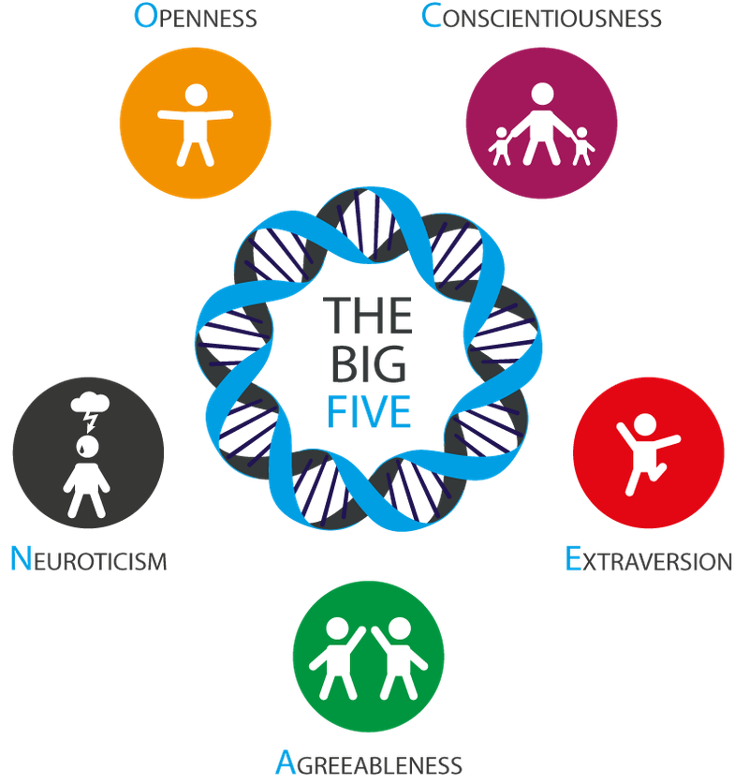
Personality Theories / Model
Big Five Personality Traits Model

Slide 13
Big 5 Personality Traits
Emotional stability = the degree to which a person is calm, enthusiastic, and secure, rather than tense, nervous, depressed, moody, or insecure.
Extroversion = the degree to which a person is sociable, talkative, assertive, and comfortable with interpersonal relationships.
Conscientiousness = the degree to which a person is focused on a few goals, thus behaving in ways that are responsible, dependable, persistent, and achievement oriented.
Agreeableness = the degree to which a person is able to get along with others by being good-natured, cooperative, forgiving, understanding, and trusting.
Openness to experience = the degree to which a person has a broad range of interests and is imaginative, creative, artistically sensitive, and willing to consider new ideas.
Notes:
PERSONALITY AND BEHAVIOR
An individual’s personality is the set of characteristics that underlie a relatively stable pattern of behavior in response to ideas, objects, or people in the environment. Understanding personality can help managers predict how a person might act in a particular situation. Managers who appreciate the ways their employees’ personalities differ have insight into what kinds of leadership behavior will be most influential.
There are five general dimensions that describe personality, often called the Big Five personality factors.
Extroversion refers to the degree to which a person is sociable, talkative, assertive, and comfortable with interpersonal relationships.
Agreeableness refers to the degree to which a person is able to get along with others by being good-natured, cooperative, forgiving, understanding, and trusting.
Conscientiousness refers to the degree to which a person is focused on a few goals, thus behaving in ways that are responsible, dependable, persistent, and achievement oriented.
Emotional stability refers to the degree to which a person is calm, enthusiastic, and secure, rather than tense, nervous, depressed, moody, or insecure.
Openness to experience refers to the degree to which a person has a broad range of interests and is imaginative, creative, artistically sensitive, and willing to consider new ideas.
These factors represent a continuum. A person may have a low, moderate, or high degree of each quality. Having a moderate-to-high degree of each personality factor is considered desirable for a wide range of employees, but is not a guarantee for success.
Many companies use personality testing to hire, evaluate, or promote employees despite the fact that there is little hard evidence that these personality tests are valid predictors of job or relationship success.

Slide 14
The “Big Five” Personality Factors* (Each factor is a continuum of many related traits)
Emotional Stability (Adjustment)
High
Low
(Stable, confident, effective) (Nervous, self-doubting, moody)
Extroversion (Sociability)
(Expressive , energetic, self-dramatizing) (Shy, unassertive, reserved)
Conscientiousness
(Planful, neat, dependable) (Impulsive, careless, irresponsible)
Agreeableness
(Warm, tactful, considerate) (Independent, cold, rude)
Intellectual Openness
(Imaginative, curious, original) (Dull, unimaginative, literal-minded)

Slide 15
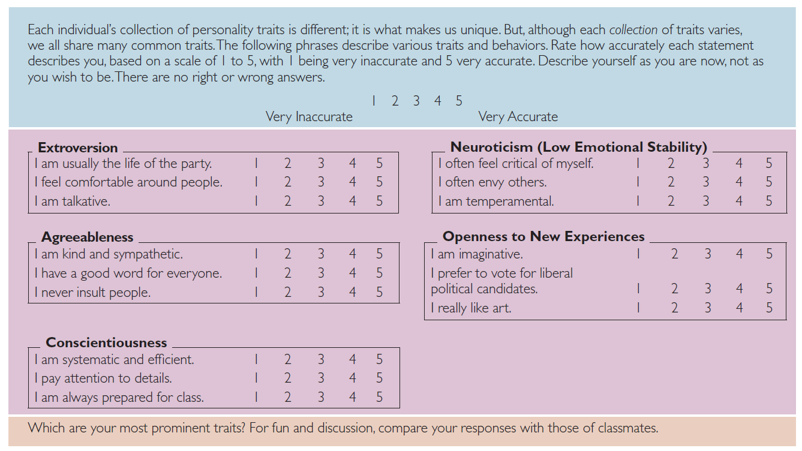
The Big Five Personality Traits

Slide 16
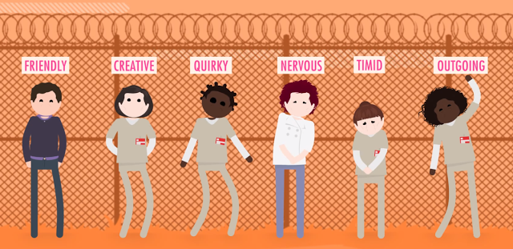
Other Personality Traits Relevant to OB
Core Self-evaluation
Self-esteem
Locus of Control
Machiavellianism
Narcissism
Self-monitoring
Risk taking
Type A vs. Type B personality
Proactive Personality

Slide 17
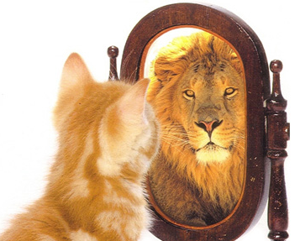
Core Self-Evaluation: Two Main Components
Self Esteem
Self-esteem (“self-worth”) is part of emotional intelligence
Individuals’ degree of liking or disliking themselves.
Locus of Control (“fate vs. personal control”) is part of conscientiousness
The degree to which people believe they are masters of their own fate.
Internal locus of control Individuals who believe that they control what happens to them.
External locus of control Individuals who believe that what happens to them is controlled by outside forces such as luck or chance.
Notes:
Self-esteem is made up of the thoughts, feelings, and opinions we have about ourselves. That means self-esteem isn't fixed. It can change, depending on the way we think. Over time, habits of negative thinking about ourselves can lower self-esteem.
Sometimes, people don't even realize that they're thinking so negatively about themselves. But once you're aware of it, and know that the way you think is up to you, you can begin to change the way you think. And changing the way you think about yourself changes the way you feel about yourself. So if you want to feel better about yourself, try some of these things:
Manage your inner critic
Focus on what goes well for you
Aim for effort rather than perfection
View mistakes as learning opportunities
Edit thoughts that get you feeling inferior
Remind yourself that everyone excels at different things
Try new things, and give yourself credit.
Recognize what you can change and what you can't
Set goals
Take pride in your opinions and ideas
Accept compliments
Make a contribution

Slide 18
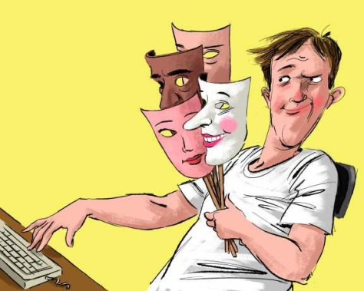
Machiavellianism
Degree to which an individual is pragmatic, maintains emotional distance, and believes that ends can justify means.
Conditions Favoring High Machs
Direct interaction with others
Minimal rules and regulations
Emotions distract for others
Notes:
The personality characteristic of Machiavellianism (often abbreviated Mach ) is named after Niccolo Machiavelli, who wrote in the sixteenth century on how to gain and use power. An individual high in Machiavellianism is pragmatic, maintains emotional distance, and believes ends can justify means. “If it works, use it” is consistent with a high-Mach perspective. A considerable amount of research has found high Machs manipulate more, win more, are persuaded less, and persuade others more than do low Machs. They like their jobs less, are more stressed by their work, and engage in more deviant work behaviors. Yet high-Mach outcomes are moderated by situational factors.

Slide 19
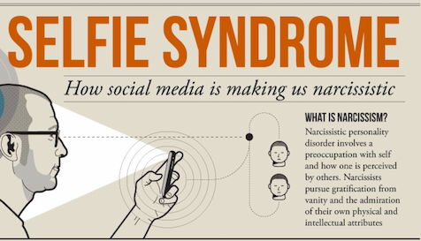
Narcissism
A magnificent sense of self-importance.
Requires excessive admiration
Has a sense of entitlement
Is arrogant.
Extreme selfishness and a craving for admiration, as characterizing a personality type.
Tends to be rated as less effective.
Notes:
Narcissism: excessive interest in or admiration of oneself and one's physical appearance.
A clinical list of Narcissistic personality characteristics
This article on dealing with narcissistic children has a good list, and has some of the items that I noted.
Reality distortion and Inability to See and Hear -- The child sees situations through his own sense of woundedness and neediness. . .
Mood Switching --The child's fractured self is caught in mood swings. She may go back and forth between "I'll be good" and pouting or outrage because she isn't getting what she wants. . .
Poor Impulse Control and Frustration Tolerance -- The child is highly reactive to outside stimuli that seem to threaten his sense of self and cannot delay gratification. He wants things NOW! . . .
Poor Ego Boundaries and Need for Control -- The child cannot view things from any other perspective other than his own. He is so caught in his own neediness that he cannot feel empathy for others.
Denial of Uncomfortable Feelings --The child keeps the focus on what he wants not how he feels. His constant demanding keeps him from feeling the pain inside.
Frequent Anger and Rage --The child substitutes anger and tantrums as a way of keeping her uncomfortable feelings from being experienced. She becomes a master of rationalization and justification of her explosive actions . . .
Need for Admiration --The child erroneously believes that he is special and should be given special privileges. . .
Grandiosity and Fantasy --The child spins grandiose fantasies to cover up the internal wounds of his fractured self. He sets up elaborate fantasy schemes of winning, becoming powerful or gaining revenge for injustice. Daydreams of becoming rich and famous without talent or hard work are common.
Idealization and Devaluation of Teachers or Therapists --The child will make you feel that you are wonderful and special as long as you humor her. "As long as you give me what I want, you are the ideal person for me" . . .
Externalization of Blame --The child cannot allow the bad feelings of being at fault for anything. He/she/they/YOU are the problem! He avoids feeling vulnerable by blaming others.

Slide 20
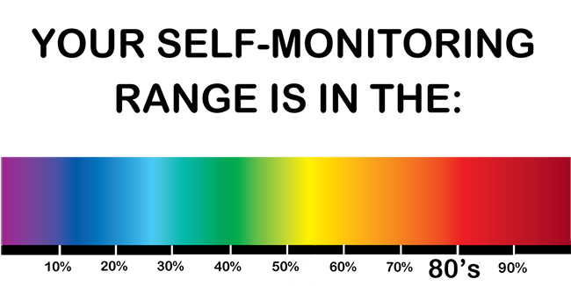
Self-Monitoring
A personality trait that measures an individual’s ability to adjust his or her behavior to external, situational factors.
High Self-Monitors
Receive better performance ratings
Likely to emerge as leaders
In addition, high self- monitoring managers tend to be more mobile in their careers, receive more promotions (both internal and cross-organizational), and are more likely
to occupy central positions in an organization.
Notes:
She’s unable to adjust her behavior to fit changing situations. As she puts it, “I’m true to myself. I don’t remake myself to please others.” We would describe Joyce as a low self-monitor.
Self-monitoring refers to an individual’s ability to adjust his or her behavior to external, situational factors. Individuals high in self-monitoring show
considerable adaptability in adjusting their behavior to external situational factors. They are highly sensitive to external cues and can behave differently
in different situations, sometimes presenting striking contradictions between their public persona and their private self. Low self-monitors, like Joyce, can’t disguise themselves in that way. They tend to display their true dispositions and attitudes in every situation; hence, there is high behavioral consistency between who they are and what they do.

Slide 21


Risk-Taking
High Risk-taking Managers
Make quicker decisions
Use less information to make decisions
Operate in smaller and more entrepreneurial organizations
Low Risk-taking Managers
Are slower to make decisions
Require more information before making decisions
Exist in larger organizations with stable environments
Notes:
People differ in their willingness to take chances, a quality that affects how much time and information they need to make a decision. For instance, managers worked on simulated exercises that required them to make hiring decisions. High risk-taking managers made more rapid decisions and used less information than did the low risk takers. Interestingly, decision accuracy was the same for both groups.
Previous studies have shown managers in large organizations to be more risk averse than growth-oriented entrepreneurs who actively manage small businesses. The work population as a whole also differs in risk propensity. It makes sense to recognize these differences and even consider aligning them with specific job demands.

Slide 22
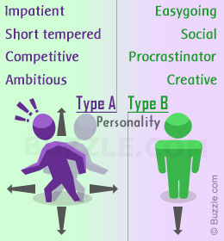
Personality Type
Type A
Type B
Always moving, walking, and eating rapidly;
Feel impatient with the rate at which most events take place;
Strive to think or do two or more things at once;
Cannot cope with leisure time;
Are obsessed with numbers, measuring their success in terms of how many or how much of everything they acquire.
Never suffer from a sense of time urgency with its accompanying impatience;
Feel no need to display or discuss either their achievements or accomplishments;
Play for fun and relaxation, rather than to exhibit their superiority at any cost;
Can relax without guilt.

Slide 23
Proactive Personality
Did you ever notice that some people actively take the initiative to improve their current circumstances or create new ones?
These are proactive personalities.
Identifies opportunities, shows initiative, takes action, and continues until meaningful change occurs.
Creates positive change in the environment, regardless or even in spite of constraints or obstacles.
Notes:
Did you ever notice that some people actively take the initiative to improve their current circumstances or create new ones? These are proactive personalities. Those with a proactive personality identify opportunities, show initiative, take action, and persevere until meaningful change occurs,
compared to others who passively react to situations. Proactives create positive change in their environment, regardless of, or even in spite of, constraints or obstacles.

Slide 24
Goal Orientation as a Personality Trait
Learning Goal Orientation
Performance Goal Orientation
Individuals with this orientation:
Focus of increased competence and mastering something new – acquiring new skills
Evaluate competence according to whether a task is mastered or a skill developed
More likely to choose difficult and challenging tasks that is associated with better individual job performance
Individuals with this orientation:
Demonstrate and validate competence by seeking favorable judgments from others (e.g., a supervisor) or avoiding negative judgments
Evaluate competence according to how they compare to others
Interprets effort and outcomes as diagnostic of their ability (high efforts level → indicator of low ability → results in withdrawal from further effort)

Slide 25
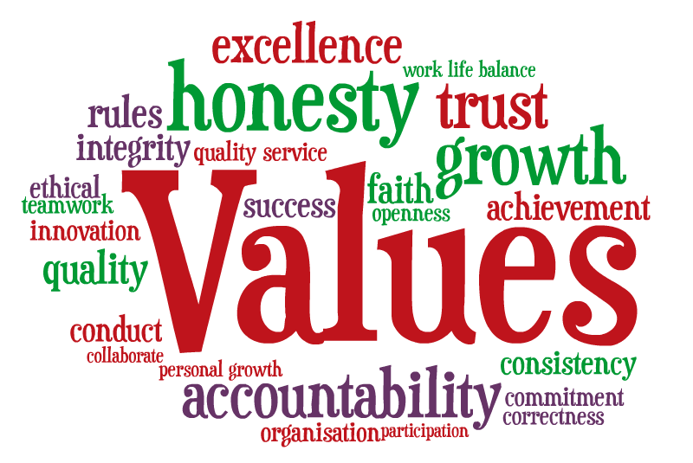
Values
Definition: Mode of conduct or end state is personally or socially preferable (i.e., what is right, good or desirable?)
Value System: A hierarchy based on a ranking of an individual’s values in terms of their intensity.
The relative importance we assign to values such as freedom, pleasure, self-respect, honesty, obedience, and equality.
Terminal Values
Desirable end-states of existence; the goals that a person would like to achieve during his or her lifetime
Instrumental Values
Preferable modes of behavior or means of achieving one’s terminal values.
Read this article: https://www.mindtools.com/pages/article/newTED_85.htm
Notes:
Values represent basic convictions that “a specific mode of conduct or end-state of existence is personally or socially preferable to an opposite or converse mode of conduct or end-state of existence.” They contain a judgmental element in that they carry an individual’s ideas as to what is right, good, or desirable. Values have both content and intensity attributes. The content attribute says a mode of conduct or end-state of existence is important. The intensity attribute specifies how important it is. When we rank an individual’s values in terms of their intensity, we obtain that person’s value system . All of us have a hierarchy of values that forms our value system. We find it in the relative importance we assign to values such as freedom, pleasure, self-respect, honesty, obedience, and equality.

Slide 26
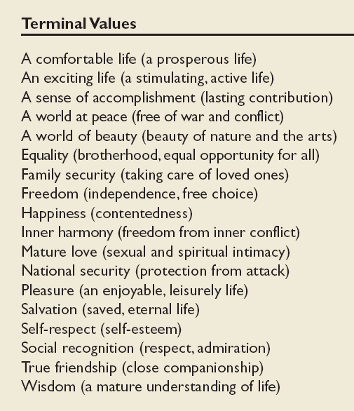
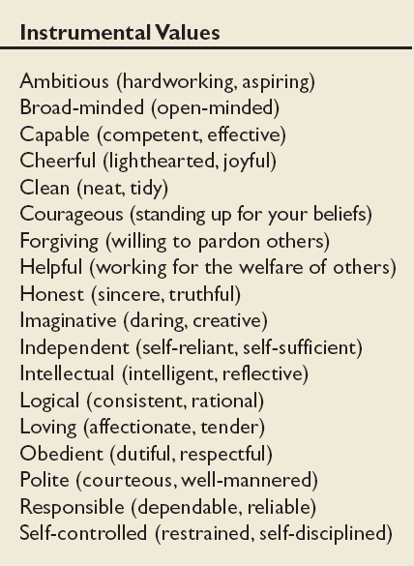

Slide 27
Importance of Values
Provide understanding of the attitudes, motivation, and behaviors of individuals and cultures.
Influence our perception of the world around us.
Represent interpretations of “right” and “wrong.”
Imply that some behaviors or outcomes are preferred over others.
Values often underlie and explain attitudes, behaviors, and perceptions. So knowledge of an individual’s value system can provide insight into what makes the person “tick.”
Suppose you enter an organization with the view that allocating pay on the basis of performance is right, while allocating pay on the basis of seniority is wrong. How will you react if you find the organization you’ve just joined rewards seniority and not performance?
You’re likely to be disappointed—and this can lead to job dissatisfaction and a decision not to exert a high level of effort because “It’s probably not going to lead to more money anyway.

Slide 28
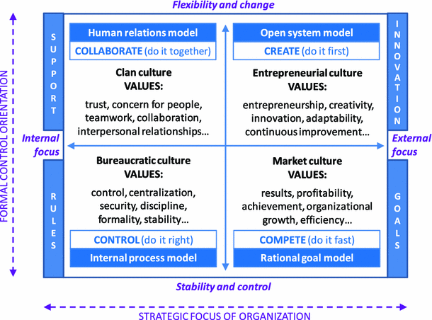
Organizational Values
Power
Rewards
Effectiveness
Efficiency
Fairness
Teamwork
Law and Order
Competitiveness
Opportunism

Slide 29
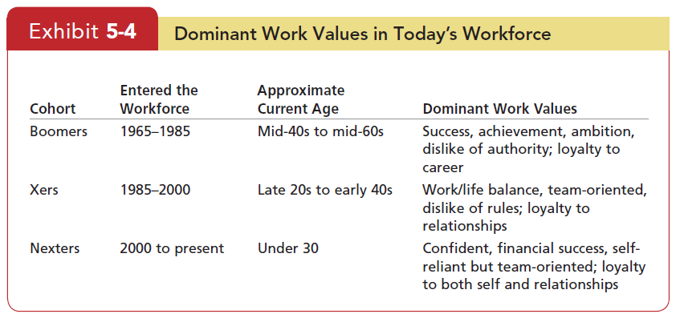
Work Values
Commitment
Self-Motivation
Integrity
Hard Work
Trust
Achievement
Contentment
Career progress

Slide 30
Linking an Individual’s Personality and Values to the Workplace
Thirty years ago, organizations were concerned only with personality because their primary focus was to match individuals to specific jobs.
That concern has expanded to include how well the individual’s personality and values match the organization.
Why?
Because managers today are less interested in an applicant’s ability to perform a specific job than with his or her flexibility to meet changing situations and commitment to the organization.
Person–job fit vs. Person–organization fit

Slide 31
Linking an Individual’s Personality and Values to the Workplace
Person-Job Fit
Person-Organization Fit
The effort to match job requirements with personality characteristics is known as personality–job fit theory.
John Holland presented six personality types and proposes that satisfaction and the propensity to leave a position depend on how well individuals match their personalities to a job.
E.g: A realistic person in a realistic job is in a more compatible situation than a realistic person in an investigative job.
Argues that people are attracted to and selected by organizations that match their values, and they leave organizations that are not compatible with their personalities.
E.g: People high on openness to experience fit better in organizations that emphasize innovation rather than standardization

Slide 32
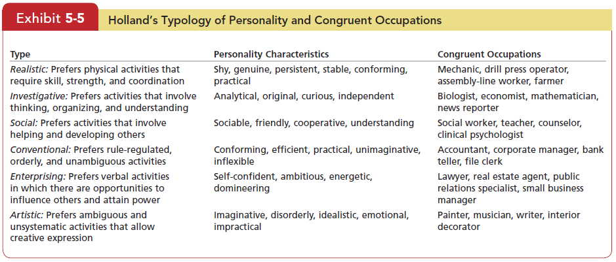
Achieving Person-Job Fit
Certain personality types and proposes that the fit between personality type and occupational environment determines satisfaction and turnover.

Slide 33
Dimensions of Culture Hofstede’s Framework
International Values
Individualism
The degree to which people prefer to act as individuals rather than a member of groups.
Collectivism
A tight social framework in which people expect others in groups of which they are a part to look after them and protect them.

Slide 34
Dimensions of Culture Hofstede’s Framework (cont’d)
International Values
Masculinity
The extent to which the society values traditional masculine roles such as achievement, power, and control.
Femininity
The extent to which there is little differentiation between roles for men and women.

Slide 35
Dimensions of Culture Hofstede’s Framework (cont’d)
International Values
Uncertainty Avoidance
The extent to which a society feels threatened by uncertain and ambiguous situations and tries to avoid them.
High Uncertainty Avoidance: Society does not like ambiguous situations & tries to avoid them.
Low Uncertainty Avoidance: Society does not mind ambiguous situations & embraces them.

Slide 36
Dimensions of Culture Hofstede’s Framework (cont’d)
International Values
Long-term Orientation
A national culture attribute that emphasizes the future, thrift, and persistence.
Short-term Orientation
A national culture attribute that emphasizes the present and the here and now.

Slide 37
Dimensions of Culture Hofstede’s Framework (cont’d)
International Values
Power Distance
Social distance among people depending upon management style, willingness of subordinates to disagree with superiors, and the educational level and status accruing to particular roles
Countries with a high level of power distance include France, Spain, Hong Kong & Iran
Countries as diverse as Germany, Italy, Australia & USA characterized as low power distance societies.

